Slide 1
Road Inventory, MMHIS, and ATIS
Elisha Wright-Kehner, P.E.
Staff Research Engineer
SIR August 16, 2019

Slide 2
Roadway Inventory

Slide 3
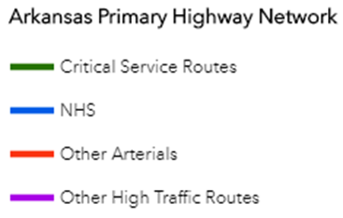
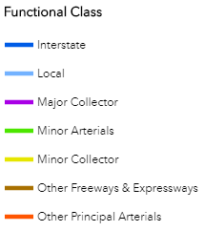
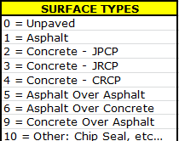
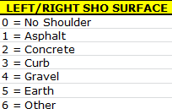
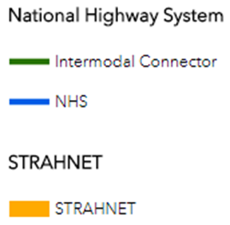
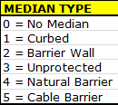
Road Inventory:
Roadway Classifications, Funding Codes, & Characteristics
Notes:
Specify that the authoritative LRS is owned/maintained by TPP division (in partnership with AGISO) while SIR division owns/maintains the RoadInventory, ADT, & Pavement Data.
I.E. TPP maintains the LRS while SIR maintains a portion of the ‘LRM’, while there are still other datasets across the DOT that make up the totality of the LRM. That highlights the importance of enterprise data governance.

Slide 4
Roadway Inventory – What are current uses?
Notes:
NHS, County, public road mileage, state highway mileage, VMT, number of lanes, Rural / Urban Area mileage,
Road and Street Report
Arkansas Passing Lanes

Slide 5
Notes:
Road Inventory was started a long time ago in a galaxy far far away. It was documented before the 1980’s but pre-1994 was lost once the data was put on the mainframe in 1994. Road Inventory resided on the Mainframe until it was converted to SQL in 2008.

Slide 6
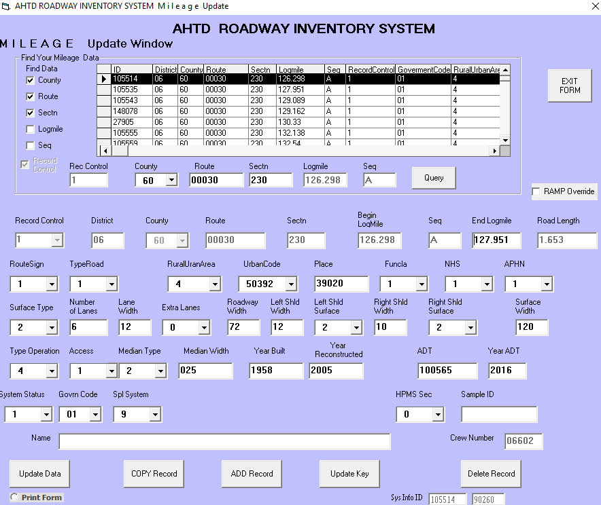
Roadway Inventory
Notes:
Road Inventory resided on the Mainframe until it was converted to SQL in 2008. Not much has been updated since 2008.

Slide 7
Roadway Inventory
Notes:
Road Inventory will be upgraded with a new interface screen as well as the SQL database will be moved onto a current platform.
We also plan on having a closer linkage to the ARNOLD network and implementing a new workflow process to ensure all users know when changes occur.
MIRE Data implementation by 2026.

Slide 8
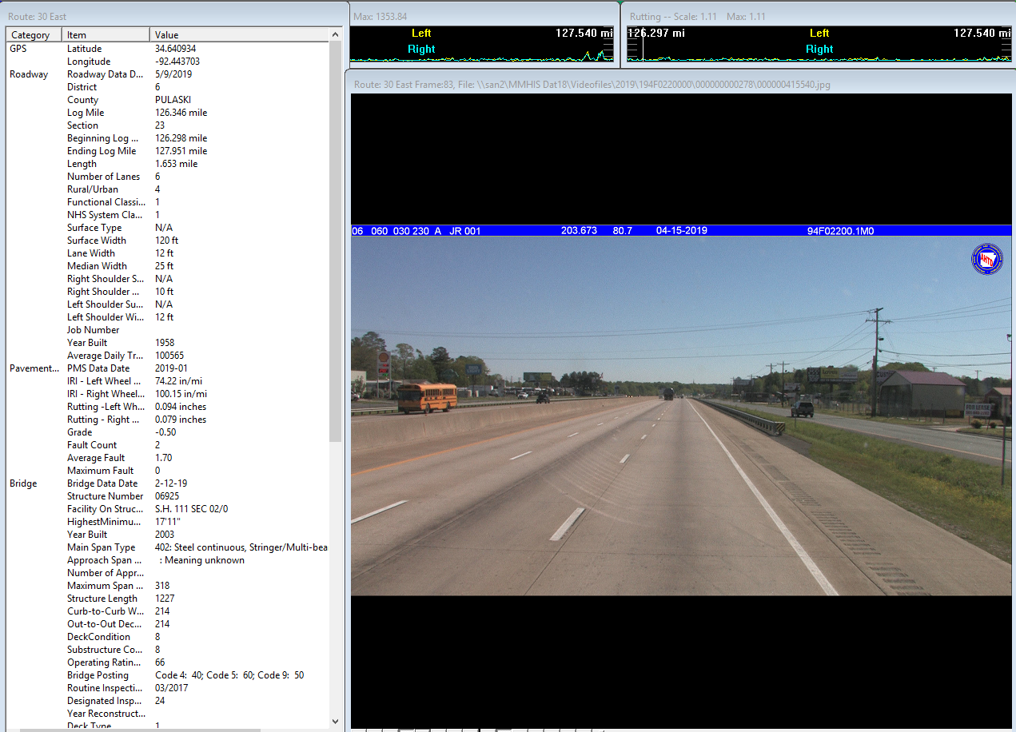
Multimedia Highway Information System (MMHIS)
Notes:
What is MMHIS?
A visual way to see data usually stored in a database.
Connects road views with other data sets.
Allows for visual conformation of roadway assets and features.

Slide 9
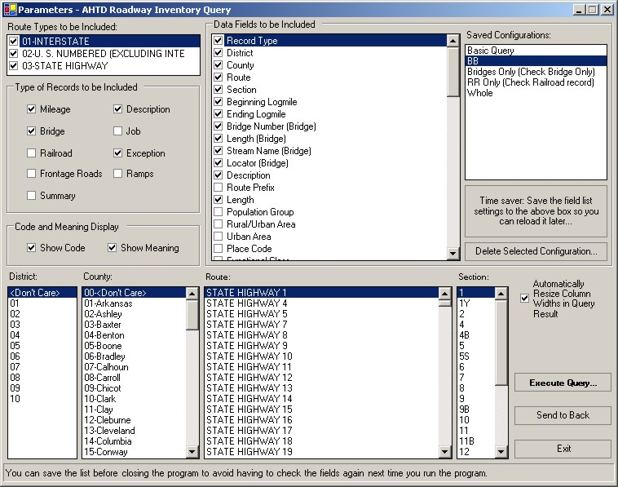
Notes:
MMHIS is a product of Three TRC-Projects
TRC - 9606
TRC - 9904
TRC - 0202
The Department received its first Authorized Computer in November of 2000; started with interstate only.

Slide 10
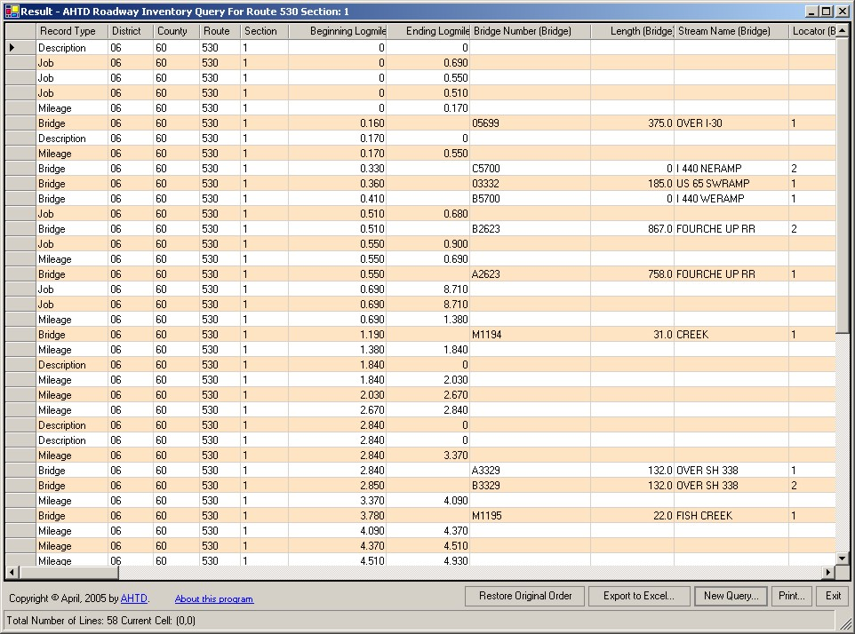

Slide 11
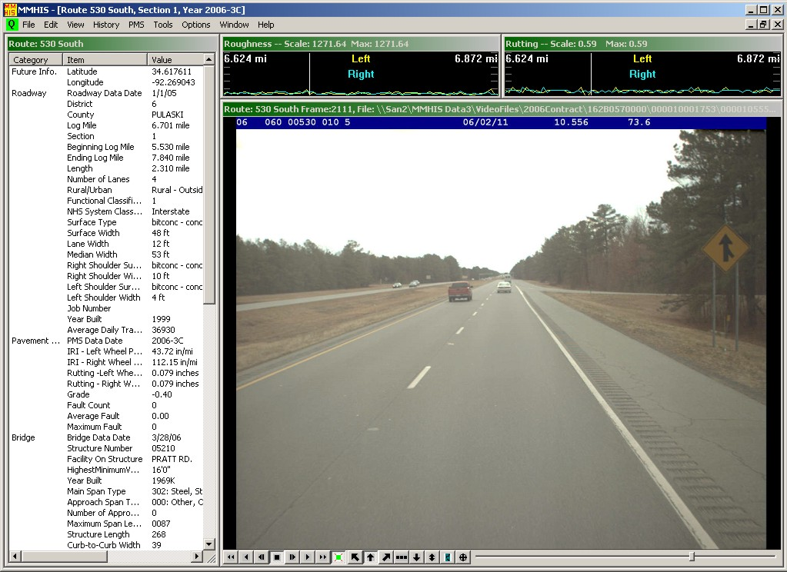

Slide 12
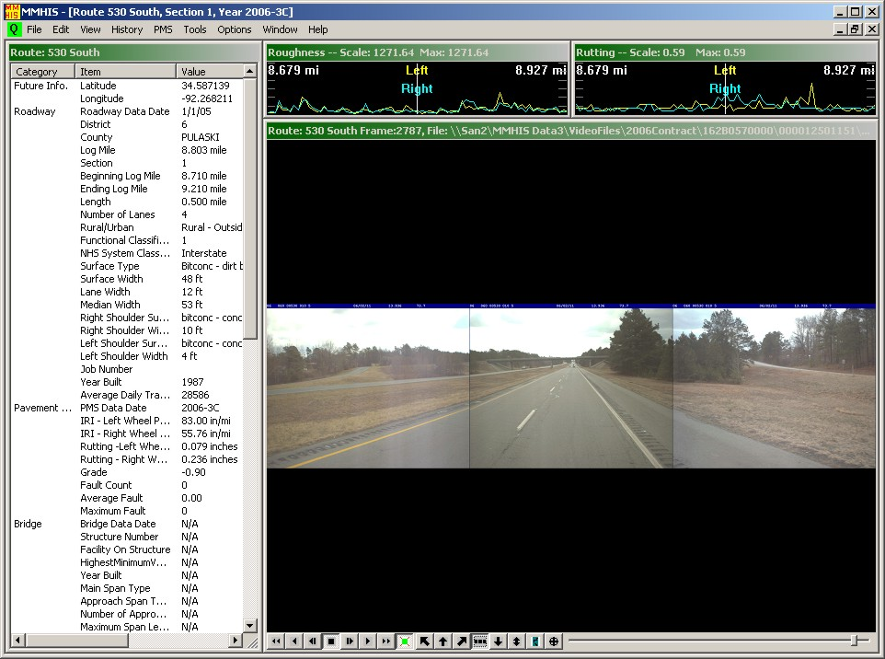
Notes:
This is run through an Access database. So when you are using this you are literally running hundreds of tables in the background.
The folders lock up when you are using a newer operating system.

Slide 13
MMHIS 2.0 – In Development
SQL Framework
4 tables
Source data changed
Back end
Unlimited expandability
Customizable display
Flexibility
Clickable map
District data
Notes:
New SQL Framework
Only consist of 4 tables
Source data can be changed easily
Easier data processing on the back end
No limit on number of field, unlimited expandability
Users will have a customizable display
More flexibility to only show data that you want to see
Clickable map similar to ATIS
District data can be hosted at District for faster speeds
Not loosing historical data.

Slide 14
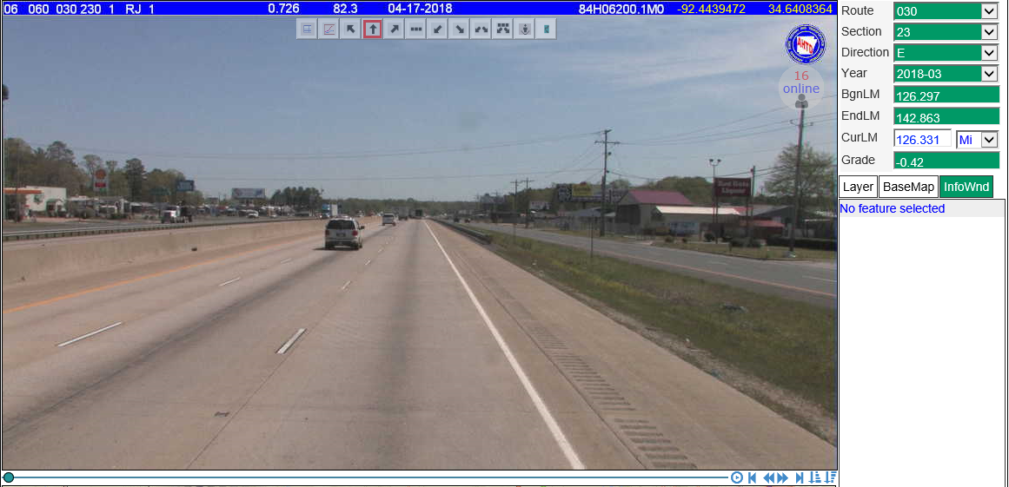
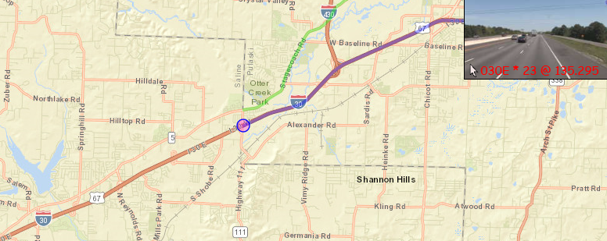
Arkansas Traffic Information System
Notes:
Developed in 2016, as a proof-of-concept of Greg Nation and George Gong.
Basically an online version of MMHIS.
Lineal data was based on ArcGIS. So data that is within this environment could be added. Users had flexibility to add their own datasets to ATIS.
Gave users ability to click on map to jump to route or log mile on route.
Gave users ability to customize viewed datasets.

Slide 15
Notes:
Please Stop using this product. We lost our programmer in May and it hasn’t been updated.

Slide 17
Notes:
Without a programmer we are not sure of the fate of ATIS. We are looking for someone that can do the coding but currently we will have to wait and see.

